Slide 2
1. Confirm layout of schools. Any modifications needed for students?
  Minor modifications will be necessary as follows:
  Reconfiguration of furnishings and equipment by maintenance staff.
  Create grab and go station at the High School with equipment from closed schools.
  Reconfigure HS classroom for 9th grade science using existing equipment.
  The middle school requires a playground for elementary grade levels. Equipment can be moved from Avis or Salladasburg.
  Coat hooks and shelves will need to be installed in the middle school classrooms. This work can be completed with District staff with minimal expense.
  If room A206 at the High School is used as a classroom additional ventilation will be required

Slide 3
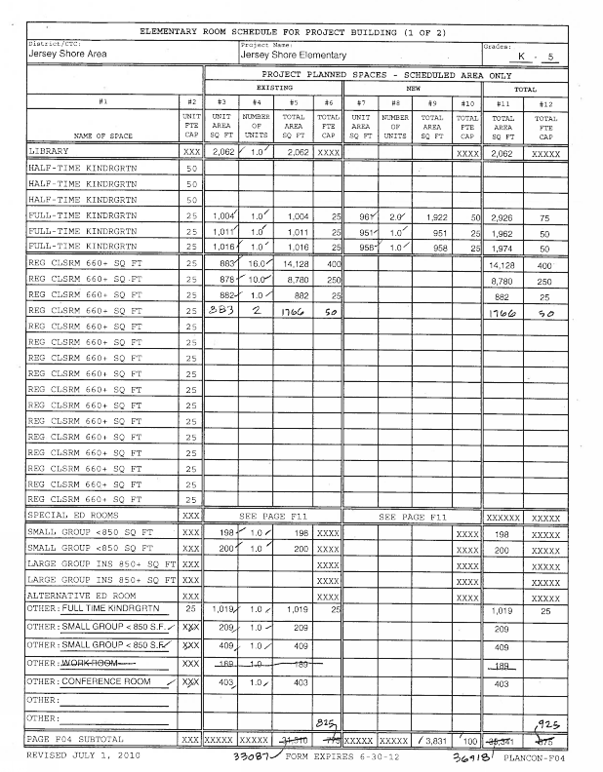
2. Explanation of new numbers JSE & HS
  The 2010 feasibility study reported the capacity of the existing building prior to the renovation and addition.
  The final PlanCon design approval forms reported a capacity of 925.
  PDE capacity for Kindergarten classrooms is 25 students. However, the district goal is 20 students. There are 5 Kindergarten classrooms. Therefore the current capacity is 900.
  One classroom is used for Head start and is not given a capacity.
  One reading room is underutilized and is given capacity of classroom for 25 students.

Slide 4
TERMINOLOGY RELATED TO SCHOOL CAPACITY:
  Design capacity is the number of spaces available in the building to accommodate students. Capacity per teaching station is defined by district policy, PDE standards, or industry standards.
  Functional capacity is the design capacity multiplied by a utilization factor to account for:
  Periods in the day when the space is not utilized such as lunch and planning periods
  Specialty spaces that may not be fully utilized every period
  Differences in cohort size at the elementary level
  Benchmark utilization Is used during the feasibility analysis for comparison purposes.
  Target utilization Is used during the planning and design of a facility to meet a district’s educational and financial goals.
  Actual utilization is the current number of students divided by the design capacity.
  Projected utilization Is the projected number of students divided by the design capacity
  It is current best practice to compare actual and projected utilization to benchmark utilization when conducting a feasibility study.

Slide 5
TERMINOLOGY RELATED TO SCHOOL CAPACITY:
  PDE uses a target utilization factor of 90% for secondary schools and 100% for elementary schools. These target utilization numbers were established in 1973 and are used primarily to calculate reimbursement amounts.
  Current industry standard for benchmark utilization is 90% for elementary schools and 85% for secondary schools for feasibility planning.
  When designing a facility a district can choose to set their own target utilization to fit their goals. For example, some districts are choosing a target as high as 92% for high schools in order to maximize utilization and minimize required building area. A target this high requires that teachers share classrooms so that all spaces are used during lunch and planning periods.

Slide 6
CAPACITY COMPARISON CHARTS: ELEMENTARY SCHOOLS
Notes:
In the 2010 study the Kindergarten classrooms were given a capacity of 25. in the 2018 study the classrooms are given a capacity of 20 per district educational goals.
At Salladasburg In 2010 there were 2 special education classrooms. In 2018 There is 1 special education classroom. Special education classrooms are not given a capacity.
At Avis in 2010 three classrooms space are listed as learning support and one is listed as special education. In 2018 one classroom space is listed as intermediate Unit and not given a capacity, and the learning support spaces are considered classrooms or underutilized potential classrooms. Additionally in 2010 one space was listed as a classroom and is now listed as a computer lab. Computer labs are not given a capacity at the elementary level.

Slide 7
CAPACITY COMPARISON CHARTS: SECONDARY SCHOOLS
Notes:
At the High School:
  the gymnasium was considered 1 teaching station in 2010, and is considered 2 teaching station in 2018. The space is slightly above PDE’s area for two teaching stations, has a divider and should be considered two teaching stations. This could be considered a judgment call, and has very little effect on overall utilization.
  PDE treats a natatorium as a district wide resource and does not give it capacity on this form. However, if it is used as a teaching station it should be given capacity. It was not given capacity in 2010, but is given capacity in 2018.
  There are differences in usage of space between business labs, computer labs, CTE labs, and special education.
At the Middle School:
  In 2010 the current wrestling room was considered an auxiliary gym. It is not used as a teaching station and should not be given capacity.
  The choral room was considered a music classroom in 2010 and on Tech ed room has been converted to a Keyboard lab/ music classroom.
  The current business lab was considered a business classroom lab in 2010.
  The current family and consumer science program operated as 3 teaching stations and now operates as 2 teaching stations.
  The gymnasium is slightly smaller than PDEs requirement to be considered 2 teaching stations
This line is the design capacity and should be used to calculate actual utilization benchmark comparison
This line is PDE’s functional capacity used to determine reimbursement. It should not be used in the calculations.

Slide 8
REVISED UTILIZATION ANALYSIS CHART WITH CLARIFIED TERMINOLOGY

Slide 9
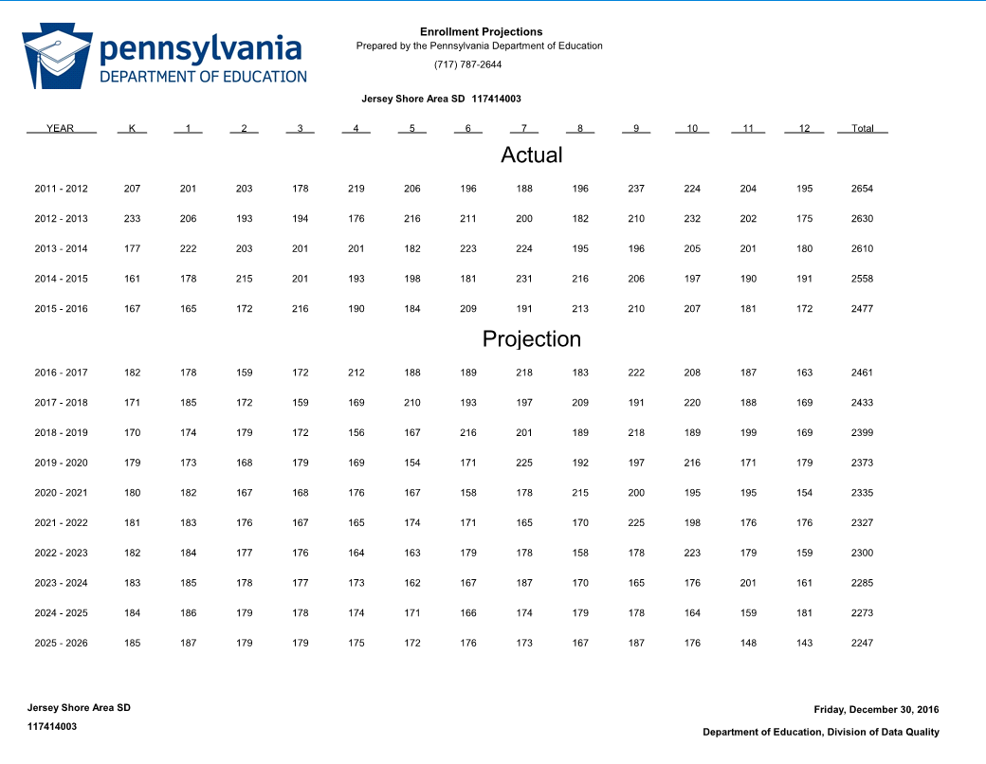
3. Is the Space sufficient? Physical presentation was not developed on how the students were going to be in the school
2435 Actual
2375 Actual

Slide 10
4. Mr. Swietzer stated he “found mistakes in numbers throughout the document”

Slide 11
5. Asking for more detail of advantages and disadvantages of options.
Option A: Close Admin
Advantages | Disadvantages
Slight reduction in building area | High Implementation costs ($1.1 to $2.3 million)
Keep all existing schools | Security concerns with Admin on HS campus
Revenue from sale of admin building | Reduced efficiency of admin management
Option B: Close Avis
Advantages | Disadvantages
Reduction in building area | Eliminating one neighborhood school
No need for Avis renovation | Requires improvements to Salladasburg MEP systems
Minimal implementation costs | Requires redistricting
Revenue from sale of Avis

Slide 12
Option C: Close Salladasburg
Advantages | Disadvantages
Reduction in building area | Eliminating one neighborhood school
Minimal implementation costs | Requires renovation of Avis
No need for improvements at Salladasburg | Requires redistricting
Revenue from sale of Salladasburg
Reduced concern of proximity to Williams Gas
Option D: Close Avis and Salladasburg
Advantages | Disadvantages
Minimizes building area | Eliminates two neighborhood schools
No need for Avis renovation
No need for improvements at Salladasburg
Minimal implementation costs
Revenue from sale of Avis and Salladasburg
All grade level students in one building

Slide 13
Grade configuration 1: K-5, 6-8, 9-12
Advantages | Disadvantages
Keeps Current configuration | Does not accommodate options B, C or D
Grade configuration 2: K-4, 5-8, 9-12
Advantages | Disadvantages
Minimal change from current configuration | Does not accommodate option B & D
 | May not accommodate options C (could require frequent redistricting)
Grade configuration 3: K-3, 4-7, 8-12
Advantages | Disadvantages
Focus on literacy curriculum in primary grades | Introduces grade 8 to high school
Provides better access to arts and STEAM program for elementary grades
Exposes 8th grade students to career pathways
Grade configuration 4: K-2, 3-6, 7-12
Advantages | Disadvantages
Focus on literacy curriculum in primary grades | Introduces grades 7 and 8 to HS
Provides better access to arts and STEAM program for elementary grades
Exposes 7th & 8th grade students to career pathways

Slide 14
6. Having a hard time understanding the suggested list of capital improvements.
Suggested Capital Improvements:
Jersey Shore | Replace domestic hot water heater.
Avis | Toilet room upgrades for ADA. Masonry restoration, replace dock door, Replace control system. Mechanical electrical, plumbing replacement with code compliant relief air system.
Salladasburg | Remove stairs to upper tier, Replace 11,060 SF of roofing on the building and 2,500 SF on the canopy, Masonry restoration, Repair EIFS system at library window replace interior doors. Replace: unit ventilators, boiler, pumps, relief air system, combustion air to boiler room, domestic hot water system. Consider complete mechanical system replacement. Replace electrical distribution panelboard, provide a remote generator annunciator panel.
Middle School | Restore or replace lockers. Inspect and repair masonry chimney Replace 60 ton chiller that serves the auditorium and admin areas. Add combustion air intake for emergency generator.
High School | Demolish Johnson house and provide additional parking, replace interior doors, replace science lab casework and equipment Add HVAC system for storage space that was converted to classrooms, replace boilers, replace air handlers, replace natatorium HVAC system, replace relief air system, provide kiln ventilation, provide dedicated (ductless split) AC to data and computer rooms. Upgrade plumbing fixtures for ADA compliance. Replace 1982 electrical switchboard
Administration | Replace 4 rooftop units.

Slide 15
7. Would like an itemized list of how you got the list of renovations. No dates attached possible addition of a future renovations page?

Slide 16
8. How to better utilize the existing space that is available in each building was never shown.
  Alternative uses would need to generate revenue to offset operation and maintenance costs.
    Potential uses include:
      Other educational uses such as head start and Intermediate unit
      Outside businesses:
        Other outside business leases such as PSECU.
          Creates security risk
          Will require renovation of spaces
          Requires management of leases
        Community uses such as YMCA, Library etc.
          Generates very little revenue

Slide 17
9. What would happen if economic turn around in the community would occur. This was never shown.
  WORKING ON THIS

Slide 18
10. “right now he says we have space in our building and I don’t see how that is true.”

Slide 19
11. Enrollment projection – why was 2021 – 22 used? Enrollment was shown by a particular year by a particular grade nothing about potential students. Would like to see some type of evaluation and impact as to what that would do to the school district.
2435 Actual
2375 Actual

Slide 20
12. On page 25 you do a grade grouping comparison, would like to see this same report done with proposed configurations .. Extend chart out by year.
The chart is intended to analyze historic patterns. However, overall projections are as follows:

Slide 21
13. Some of the graphs are 2 digits and some are single Page 14 and page 25 examples. Take all out to two digits.
  Revisions to booklet will be made as requested
14. P30 $4.42 number is old data. Want more accurate data.
  $4.42 is the most recent reliable data from an nationally recognized source.

Slide 22
15. More detail on costs to reconfigure
Item | low | High
Move Playground Equipment to MS | $15,000 | $22,000
Add Coat hooks and shelves at MS (Materials only) | $5,000 | $8,000
Add HVAC to HS room A206 if required |  | $20,000
9th Grade Science CR improvements materials only |  | $5,000
Total | $20,000 | $55,000

Slide 23
16. Need estimated completion date of suggested capital projects.
  The purpose of the feasibility study is to identify the needs. The next step would be to determine which capitol improvement projects the district intends to complete, prioritize them and develop a design and construction schedule.
Clarify term “utilization” and utilization benchmarks used.
  See answer to question 2
18. All future enrollments in new configuration.
  See answer to question 12

