Slide 2
INTRODUCTION
21st CENTURY EDUCATIONAL FACILITY DESIGN
DEMOGRAPHIC ANALYSIS
BUILDING CONDITONS AND EVALUATIONS
BENCHMARK ANALYSIS
OPTIONS

Slide 3
21st CENTURY EDUCATIONAL FACILITY DESIGN

Slide 4
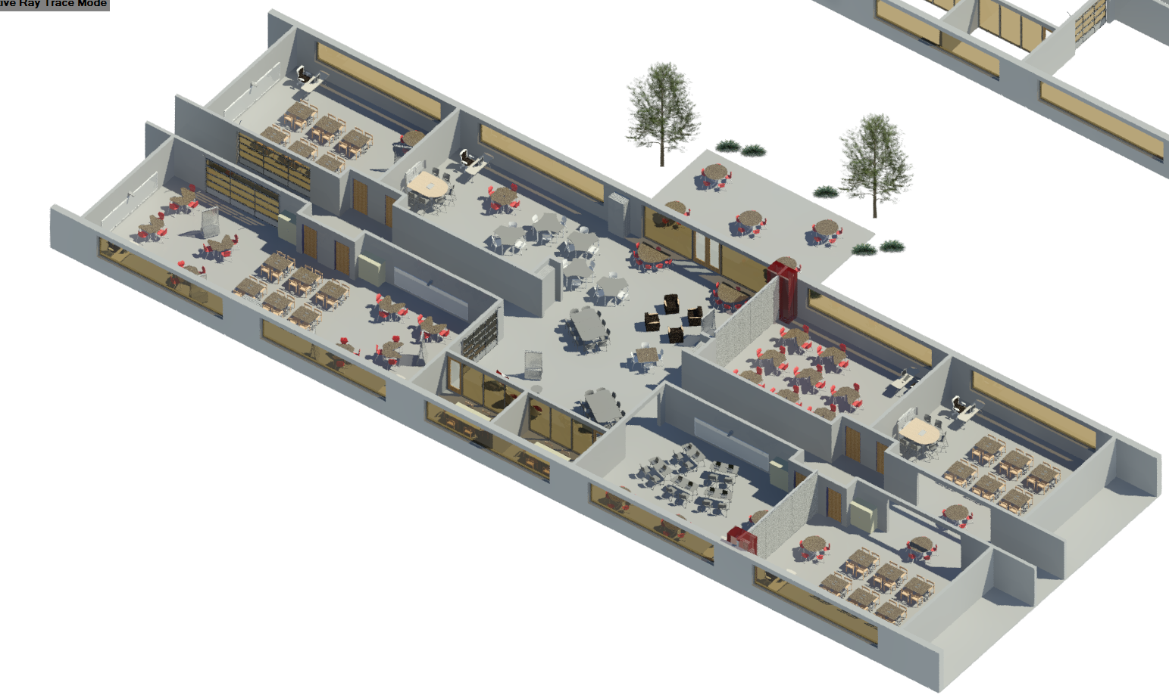
21ST CENTURY LEARNING
Priority Shifts in the educational environment
From | To
Limited Technology | Ubiquitous technology
Assertive assessment | Demonstrative assessment
Curriculum fragmented | Curriculum integrated
Conformity expected | Individuality celebrated
From | To
Teacher centric | Student centric
Passive learning | Active learning
Focus on 3 Rs | Develop 4 Cs (Critical thinking, Collaboration, Creativity, Communication
Learn in classroom | Learn anywhere
From | To
Limited Technology | Ubiquitous Technology
Assertive Assessment | Demonstrative Assessment
Curriculum Fragmented | Curriculum Integration
Conformity Expected | Individually Celebrated

Slide 5
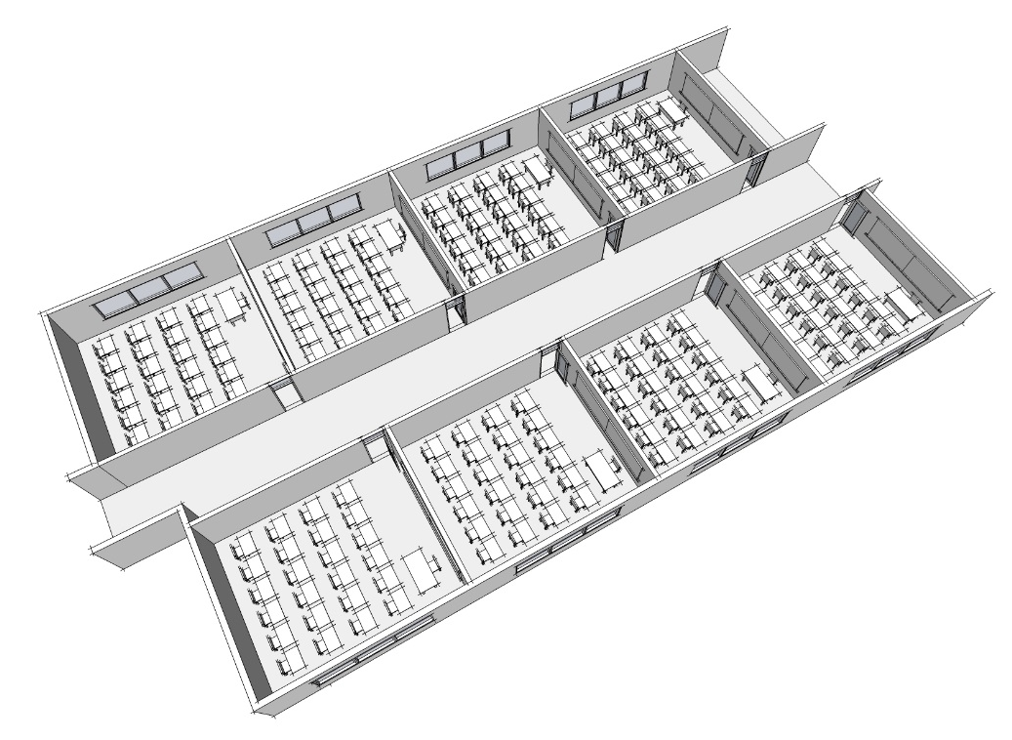
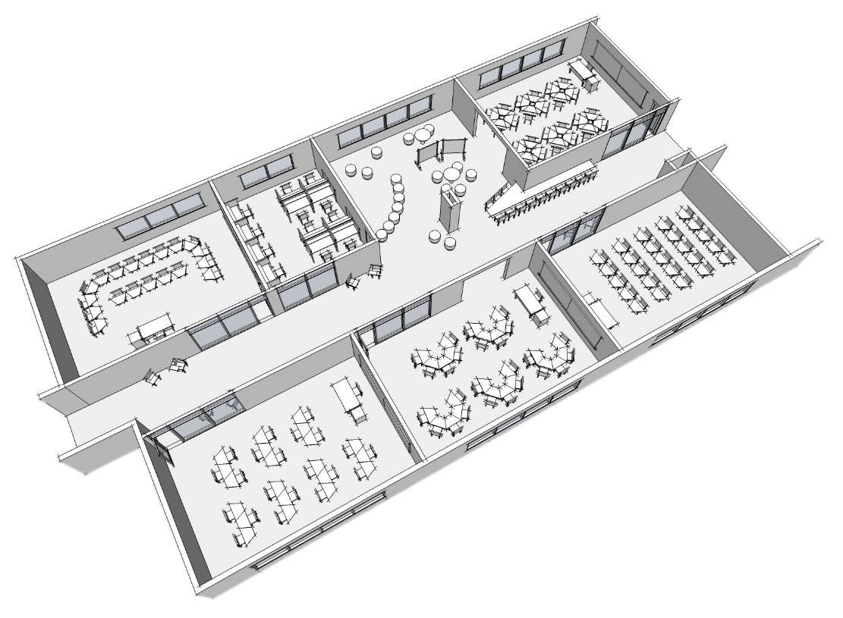
21ST CENTURY LEARNING
THEN
Mass production of education
One size fits all
Learning environment had no impact on outcomes
No foreseeable need for change = fixed
NOW
Mass customization of education
Learning environment impacts outcomes
Change = flexibility

Slide 6
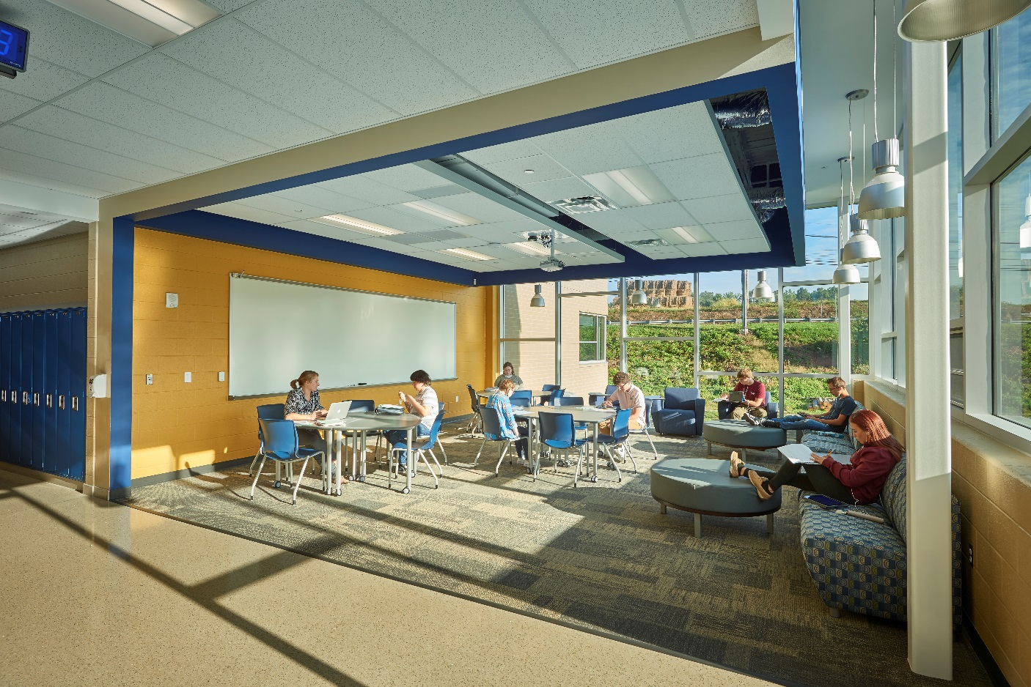
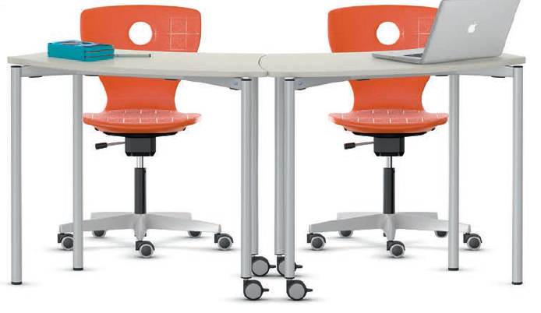
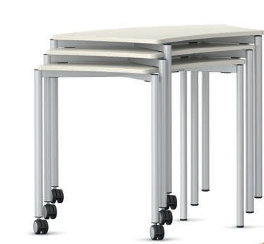
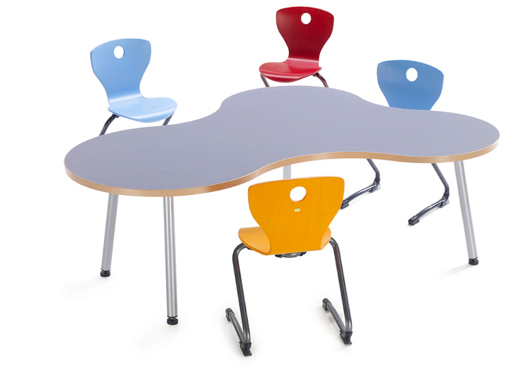
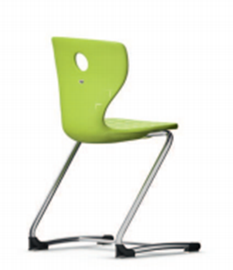
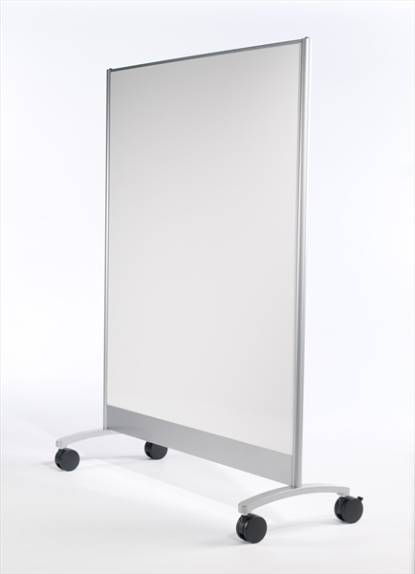
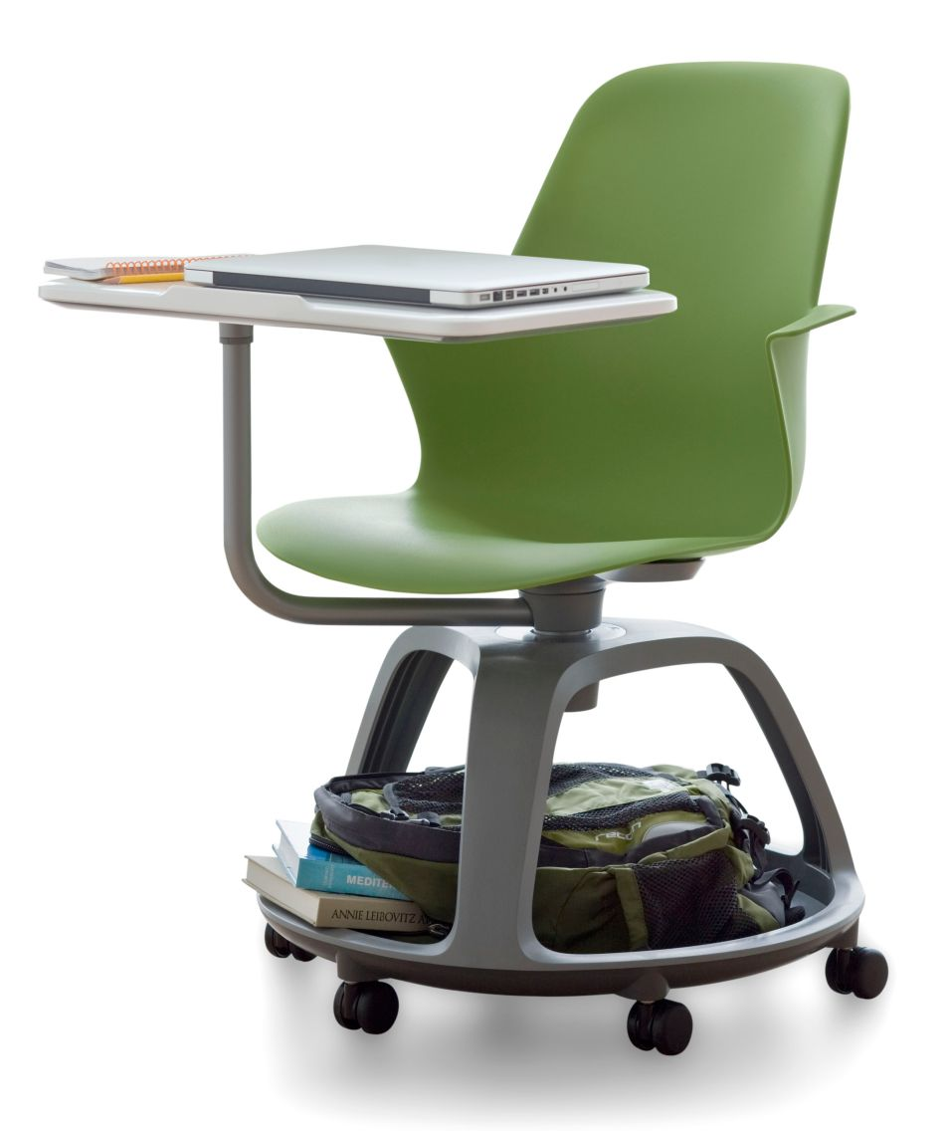
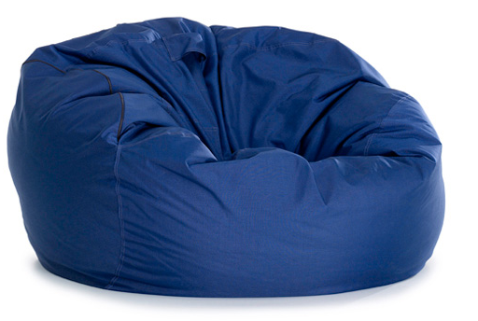
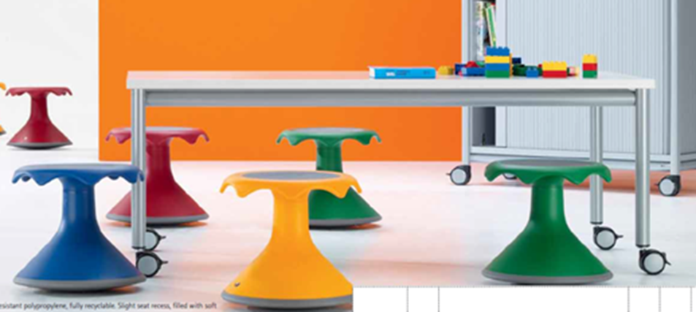
21ST CENTURY LEARNING

Slide 7
DEMOGRAPHIC ANALYSIS

Slide 8
DEMOGRAPHIC ANALYSIS
Source: Penn State Data Center
County Population Trend
County Population Projections

Slide 9
DEMOGRAPHIC ANALYSIS
District Population Trend
Students as a percentage of local population

Slide 10
DEMOGRAPHIC ANALYSIS
2017 Actual: 2,357
PDE Enrollment Projection
CRA cohort survival Enrollment Projection

Slide 11
BENCHMARK ANALYSIS

Slide 12
BENCHMARK ANALYSIS: CAPACITY

Slide 13
BENCHMARK ANALYSIS: AREA PER STUDENT
Benchmark Source: School Planning and Management Magazine Annual Construction Report average for region 2 2002-2015

Slide 14
ESTIMATED POTENTIAL COST TO MAINTAIN EXCESS AREA (RIGHT SIZING)

Slide 15
OPTIONS

Slide 16
The analysis indicates that the District’s facilities are underutilized for current and projected enrollments. Option development focuses on right sizing the District’s facilities to gain efficiency through consolidation.
          OPTION CONSIDERATIONS:
            Reduce building area
            Grade level re-alignment
            Potential savings over time
            5-10 year facility needs

Slide 17
OPTION A: Close District offices move to High School
OPTION B: Close Avis
OPTION C: Close Salladasburg
OPTION D: Close Avis and Salladasburg
Consider the following Grade level configurations:
  K-5, 6-8, 9-12 (current configuration)
  K-4, 5-8, 9-12
  K-3, 4-7, 8-12
  K-2, 3-6, 7-12

Slide 18
CURRENT CONFIGURATION
Suggested Capital Improvements:
Jersey Shore | Replace domestic hot water heater.
Avis | Toilet room upgrades for ADA. Masonry restoration, replace dock door, Replace control system. Mechanical electrical, plumbing replacement with code compliant return air system.
Salladasburg | Remove stairs to upper tier, Replace 11,060 SF of roofing on the building and 2,500 SF on the canopy, Masonry restoration, Repair EIFS system at library window replace interior doors. Replace: unit ventilators, boiler, pumps, return air system, combustion air to boiler room, domestic hot water system. Consider complete mechanical system replacement. Replace electrical distribution panelboard, provide a remote generator annunciator panel.
Middle School | Restore or replace lockers. Inspect and repair masonry chimney Replace 60 ton chiller that serves the auditorium and admin areas. Add combustion air intake for emergency generator.
High School | Demolish Johnson house and provide additional parking, replace interior doors, replace science lab casework and equipment Add HVAC system for storage space that was converted to classrooms, replace boilers, replace air handlers, replace natatorium HVAC system, replace relief air system, provide kiln ventilation, provide dedicated (ductless split) AC to data and computer rooms. Upgrade plumbing fixtures for ADA compliance. Replace 1982 electrical switchboard
Administration | Replace 4 rooftop units.

Slide 19
OPTION A
Estimated Costs:
Option A: Close DAO, move to High | Low | High
Implementation
Renovate HS E- wing lower level, Relocate Central Data Center, Relocate Culinary Arts CTE, Relocate Science Labs, Construct warehouse | $1,100,000 | $2,300,000

Slide 20
OPTION B
Estimated Costs:
Option B: Close Avis | Low | High
Implementation
Minor Middle School modifications (Scenario 3 & 4 only) | $20,000 | $50,000
Note: This option would require re-districting of elementary students in grade level configuration 1 unless additional classrooms are added to JSE.

Slide 21
OPTION C
Estimated Costs:
Option C: Close Salladasburg | Low | High
Implementation
Minor Middle School modifications (Scenario 3 & 4 only) | $20,000 | $50,000
Note: This option would require re-districting of elementary students in grade level configuration 1 unless additional classrooms are added to JSE.

Slide 22
OPTION D
Estimated Costs:
Option D: Close Avis and Salladasburg | Low | High
Implementation
Minor Middle School modifications (Scenario 3 & 4 only) | $20,000 | $50,000
Note: There is insufficient elementary level capacity in grade level configurations 1 and 2

Slide 23
POSSIBLE FUTURE RENOVATIONS
 | Low | High
0-5 year costs
Renovate Avis | $5,400,000 | $7,500,000
5-10 year costs
Renovate High School | $22,100,000 | $31,100,000
10-15 year costs
Renovate Middle School | $16,000,000 | $22,600,000
Total estimated 0-15 year cost | $43,500,000 | $61,200,000

